Slide 1
ECE 385 – Digital Systems Laboratory
Lecture 2 –Lab 3
Zuofu Cheng, Chushan Li
FALL 2021
All information please find in Blackboard System
Notes:
ECE Main Slide

Slide 2
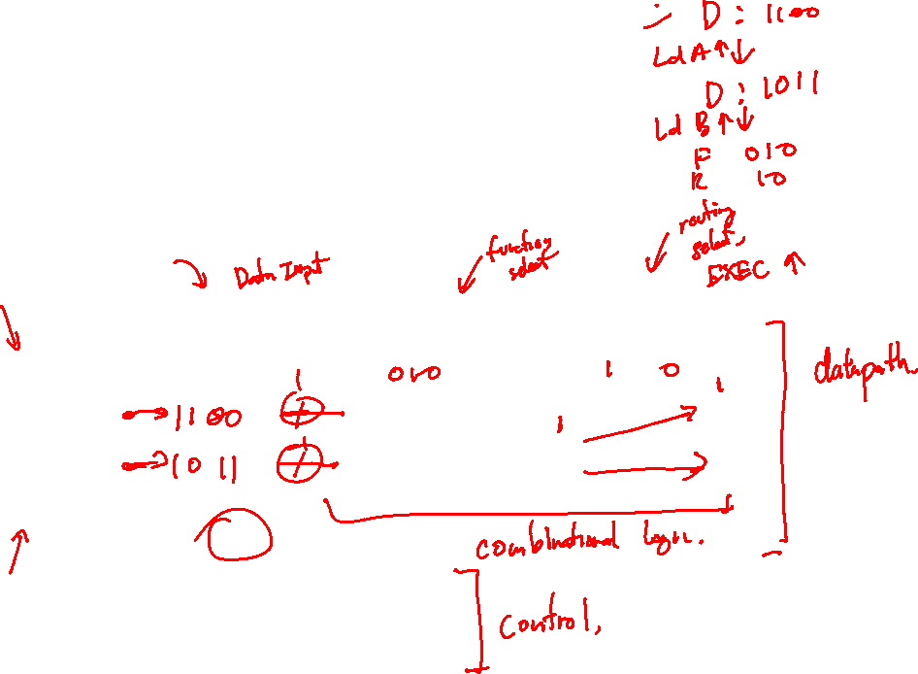
Experiment 3 – Introduction & Goals
A Bit-Serial Logic Processor
Two 4-bit registers A, B
A or B also serve as a destination register.
E.g., AND A, B, A /* A AND B=>A */
D3-D0
F2-F0
R1,R0
Load A
A
Shift Reg. A
A
One-bit wide
Logic Unit
f(A, B)
Routing
Switch
A*
Shift Reg. B
B
B
B*
Load B
Clock
Shift
CONTROL
UNIT
Execute

Slide 3
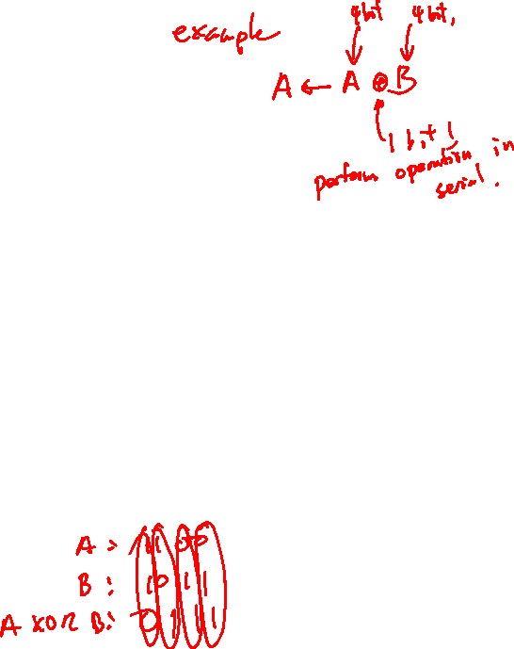
Experiment 3 – Serial Logic Processor
Design a 4-bit serial logic processor
Performs 1 of 8 logical operations on 4-bit words (1 bit at a time, serially)
All logical operations may be performed bit-wise with no additional storage
Two 4-bit registers (A, B) which can serve as source/destination of each instruction
Executes single instruction per EXECUTE signal

Slide 4
Experiment 3 – Demo Points
Show correct loading of the A and B registers. (1 point)
Show that the computation cycle is the right length. We will hit execute and hold it high. The shift registers should shift a total of 4 times. No more, no less. (1 point).
Demonstrate the four routing operations. (1 point)
Demonstrate the 8 functional operations. (1 point)
Show that the computation cycle completes even if execute returns to 0 mid-computation. This will be clocked slowly (1 Hz), and execute will be switched high. As soon as it starts shifting, execute will be switched low. The circuit must complete its computation cycle as normal. (1 point)

Slide 5
Experiment 3 – Serial Processing
All 8 operations (AND, OR, XOR, ‘1’, NAND, NOR, XNOR) can be done bitwise
Example of 8-bit bitwise addition (we won’t need to implement this because it requires extra flip-flop for carry)

Slide 6

Experiment 3 – Instructions and Design
8 Logic functions need to be implemented in the computation unit; function output routed appropriately
Instructions specified by inputs D[3:0], F[2:0], R[1,0], LoadA, LoadB
Single instruction executed on EXEC (CPU halts after execution of one instruction until EXEC is high during RE)
Function Selection Inputs |  |  | Computation Unit Output |  | Routing Selection |  | Router Output
F2 | F1 | F0 | f(A, B) |  | R1 | R0 | A’ | B’
0 | 0 | 0 | A AND B |  | 0 | 0 | A | B
0 | 0 | 1 | A OR B |  | 0 | 1 | A | F
0 | 1 | 0 | A XOR B |  | 1 | 0 | F | B
0 | 1 | 1 | 1111 |  | 1 | 1 | B | A
1 | 0 | 0 | A NAND B
1 | 0 | 1 | A NOR B
1 | 1 | 0 | A XNOR B
1 | 1 | 1 | 0000

Slide 7
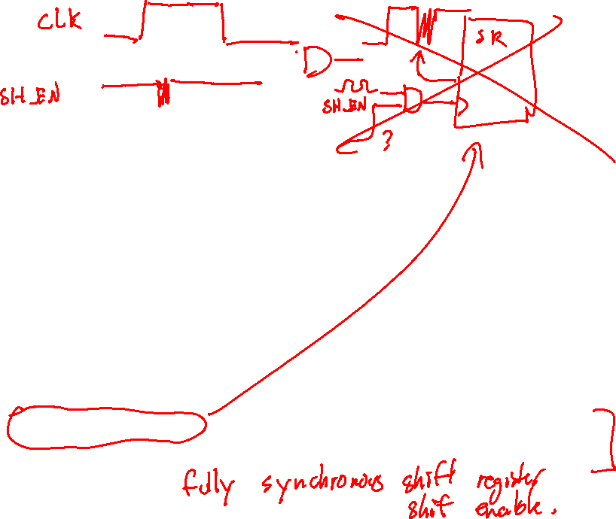
Experiment 3 – Register File
Use two shift registers
Use the parallel in capability (parallel load of D3-D0)
Use the parallel out capability (for debugging and demo)
Shift out only when EXECUTE is flipped on (and only process a 4-bit word)
Shift in from the output of the router
Clock input from the FPGA switchbox (or switch for debugging)
We will test at 1 kHz
Do not gate clock. But do not continuously shift either, will need to have control unit control mode pin.

Slide 8

Experiment 3 – Logic Unit
Will need 8-1 MUX to implement 8 functions
Example (half of what you will need)
A
B
“1”
00
01
10
11
S1
F1
4-to-1 MUX
S0
F0
F(A,B)

Slide 9
Experiment 3 – Routing Unit
Routes output of logic unit f(A,B) back to register file
R1,R0
A
f(A, B)
Routing
Switch
A*
B*
B
This switch can be implemented using just two 4-to-1 Multiplexers!

Slide 10
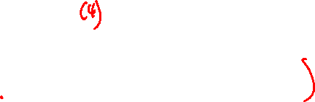
Experiment 3 – Control Unit
This is the most challenging part of this design
When EXECUTE switch is ON, the controller starts the execute cycle and completes exactly One Logic Instruction. It then Halts. The Controller will not start another execution cycle until the EXECUTE switch is OFF and then ON again.
The controller also provides the Shift signals to the shift registers for an appropriate number of times to complete one execution cycle
Should be designed as a state machine (Mealy or Moore)
Controller must execute to completion regardless of subsequent changes to EXECUTE once cycle started
Could enumerate each count as separate state, but would require more states

Slide 11
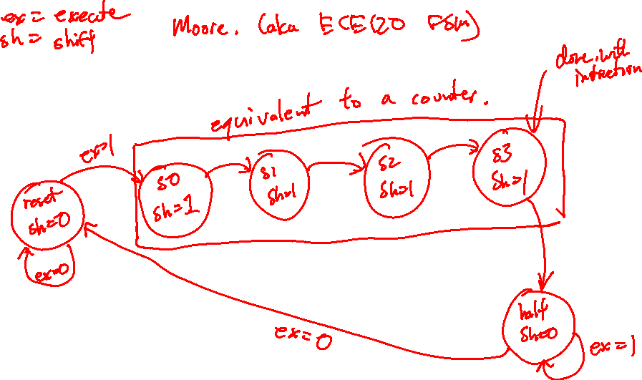
Experiment 3 – State Machine

Slide 12

Experiment 3 – State Machine (Moore)
Arcs are labeled with the counter outputs and the input Switch “EXECUTE” value
Outputs are determined by only current state
00/0
00/0
00/1
00/0
00/1
Shift
00/1
A/0
B/1
C/0
state/
shift
Reset
State
Halt
01/d
11/d
arc label
count/execute
10/d
You should include some capability to reset your controller (just involve running through once manually)

Slide 13
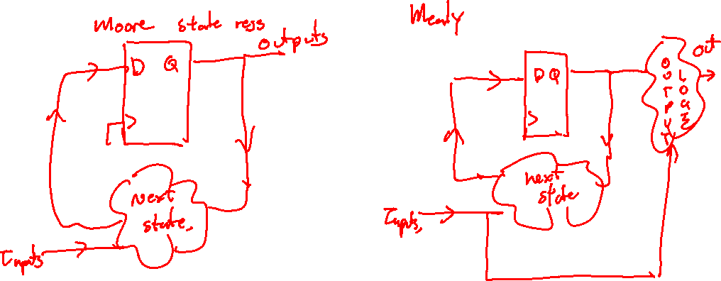
Experiment 3 – State Machine

Slide 14


Experiment 3 – State Machine (Mealy)
Arcs are labeled with both inputs & outputs
Fewer states than Moore machine (outputs depend on both state and inputs)
00/0/0
00/1/0
arc label
Input/output =>
count/execute/shift
11/d/1
0
1
00/0/0
10/d/1
state
00/1/1
01/d/1
Reset
State
Shift/Hold
State

Slide 15
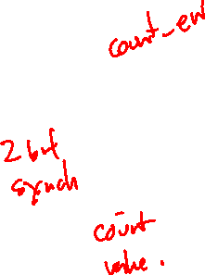
Experiment 3 – Control Unit Block Diagram (Moore / Mealy)
Reg. A,B
Shift
Shift Count
(C1, C0)
Counter
State Machine &
Combinational Logic
Execute
Input switches

Slide 16
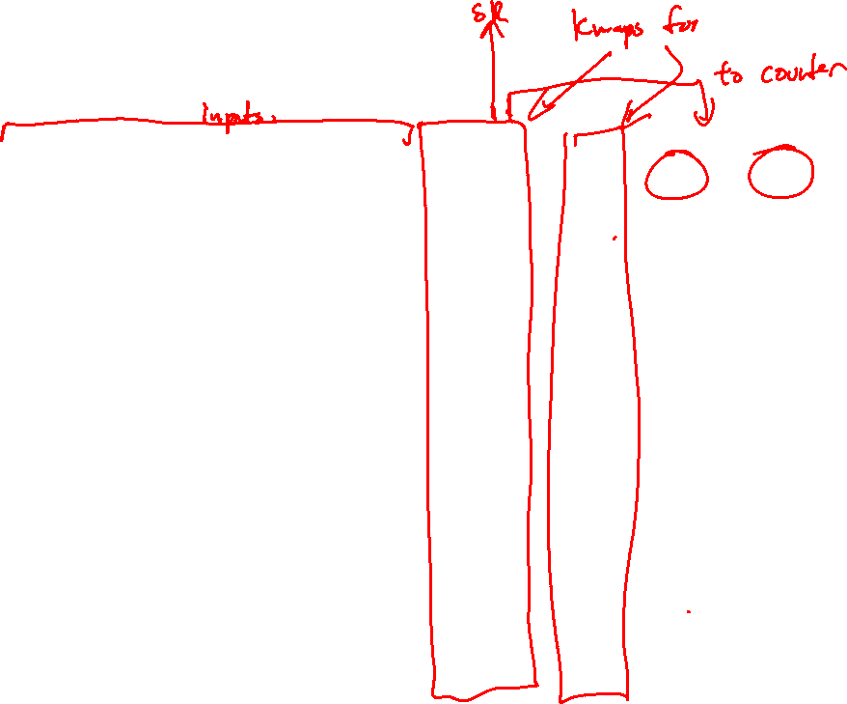
Experiment 3 –State Machine (Mealy)
Exec. Switch (‘E’) | Q | C1 | C0 | Reg. Shift (‘S’) | Q⁺ | C1⁺ | C0⁺
0 | 0 | 0 | 0 | 0 | 0 | 0 | 0
0 | 0 | 0 | 1 | d | d | d | d
0 | 0 | 1 | 0 | d | d | d | d
0 | 0 | 1 | 1 | d | d | d | d
0 | 1 | 0 | 0 | 0 | 0 | 0 | 0
0 | 1 | 0 | 1 | 1 | 1 | 1 | 0
0 | 1 | 1 | 0 | 1 | 1 | 1 | 1
0 | 1 | 1 | 1 | 1 | 1 | 0 | 0
1 | 0 | 0 | 0 | 1 | 1 | 0 | 1
1 | 0 | 0 | 1 | d | d | d | d
1 | 0 | 1 | 0 | d | d | d | d
1 | 0 | 1 | 1 | d | d | d | d
1 | 1 | 0 | 0 | 0 | 1 | 0 | 0
1 | 1 | 0 | 1 | 1 | 1 | 1 | 0
1 | 1 | 1 | 0 | 1 | 1 | 1 | 1
1 | 1 | 1 | 1 | 1 | 1 | 0 | 0

Slide 17
State Machine Encoding
Mealy and Moore machines are only one aspect of state machine design
State encoding method is also important, 3 typical methods:
Binary numerical (easiest to think about, fewest registers)
Gray encoding (minimizes bit transitions when switching states)
One-hot encoding (minimizes decoding/next state circuitry, can use to efficiently implement lab 3…how?)

Slide 18
Experiment 3 – Hints
Make design modular and unit test (note how demo points are distributed)
Do not gate clock (one inverter to shift clock edge is ok)
Use flip-flops, counters, shift registers, to store state bit(s) in control unit (fully synchronous design)
Use “don’t care” entries in state transition table to your advantage (the logic should not be very complicated)

